Slide 1
Announcements
Exam 1 bumped to Oct 1.

Slide 2
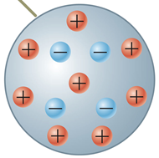
Charged Objects
Typically q=0 because there are equal numbers of ⊕ and ⊖ charges in normal matter.
Charge is given to an object by adding or removing electrons (e⁻). Here, N_{e} is the number of extra or missing e⁻.

Slide 3
Example
How can an object have 64 nC of charge?

Slide 4
Electric Field
Caused by “source charges” (I.e. everything but “test charges”.)
Direction
Points “downhill” on the Electric Potential (V) landscape.
Points away from ⊕ and toward ⊖.
Strength
Measured in newtons per coulomb (N/C).
Also measured in volts per meter (V/m). (I.e. E is the slope of V.)

Slide 5
Point Charge
Contribution is:
This is because the contribution to V is:
k is the “Coulomb Constant”:
r is our distance from the Point Charge.
Note: Both E and V get smaller as we move further away.

Slide 6
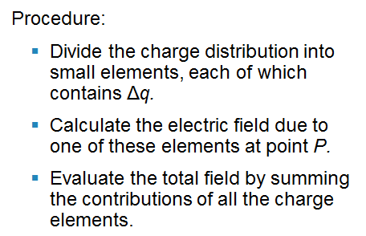
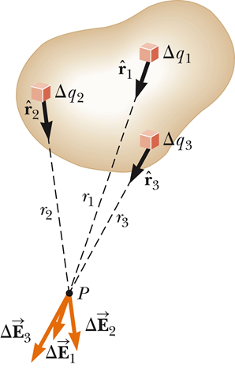
Distributions of Charges (Method 1)
Each “bit” of the line charge contributes to the E-Field

Slide 7
Charge Densities
Volume:
Surface:
Linear:

Slide 8
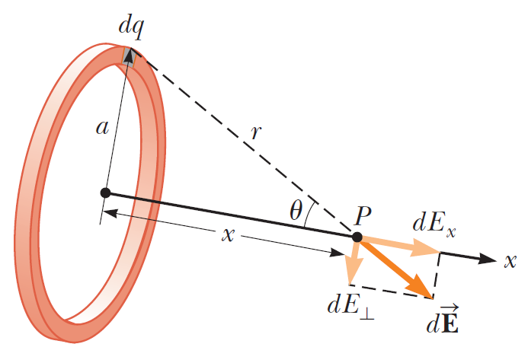
Example 23.8: Ring of Charge
a is radius of ring
x is position of P
r is distance from dq to P

Slide 9
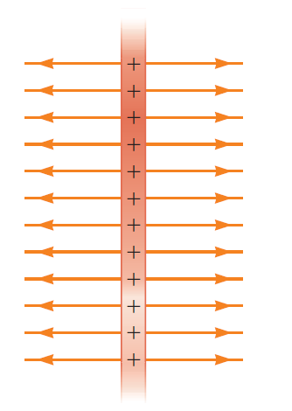
Surface Charge
σ is Charge per Unit Area
2-D double integral gives us a solution:
Doesn’t depend on position − it is “Uniform”!

Slide 10
Effect of E-Field: Causes Force
Here, q₀ is the charge “experiencing” the electric force.
This force can do things other forces can do:
Cause an acceleration (if it’s the only force in that direction)
Help balance out other forces

Slide 11
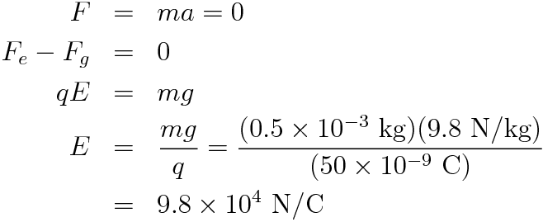
Example: Electrostatic Levitation
A 0.5 g piece of styrofoam has a charge of 50 nC. What electric field is required to levitate it?

Slide 12
Example: Electrostatic Levitation
A 0.5 g piece of styrofoam has a charge of 50 nC. What electric field is required to levitate it?

Slide 13
Example: Electrostatic Levitation
A 0.5 g piece of styrofoam has a charge of 50 nC. What electric field is required to levitate it?

Slide 14
Electrostatic Levitation: How?
To make a ⊕ bead levitate:
The electric force must point which way?
The E-Field must point which way?
We could “paint” the floor with what charges?

Slide 15
What charges are in the bead?
~50% of most objects comes from the protons.
The mass of a proton is m_{p} = 1.67 × 10⁻²⁷ kg
The number of protons in the bead is:
The charge of these protons is:
So the charge of all of the electrons is Q_{e} = −24000 C

Slide 16
What about the “charged” bead?
The neutral bead has Q_{p} = −Q_{e} = 24000 C
The charged bead has the magnitude of Q_{e} reduced by 50 nC. So, Q_{e} = −23999.999999950 C
Of course, the 24000 C was an approximation. But the net charge of 50 nC is not hard to measure.

Slide 17
Why else is the E-Field Important?
Dielectric Strength is how much E-Field a material can take.
Exceeding this value causes sparks, short circuits, and/or lightning.
For air, the dielectric strength is about 10⁶ V/m.

