Slide 1
SEASONALITY IN THE THAI STOCK INDEX
H.SWINT FRIDAY, Ph.D.
TEXAS A&M UNIVERSITY -CORPUS CHRISTI, USA
NHIEU A. BO
TEXAS A&M UNIVERSITY -CORPUS CHRISTI, USA
World Finance and Banking Symposium Conference
Singapore- December 12-13, 2014

Slide 2
INTRODUCTION/ABSTRACT
The paper examines seasonality in returns for the Stock Exchange of Thailand (SET). We use historical returns on SET composite and SET50 since the stock market was established to December 2013 to examine whether the weather has generated abnormal returns and seasonal effects on the two indices. In our previous study, we found that “Halloween effect” or “Go away in May come back Halloween Day” in the Vietnam stock index (VN-index) were statistically attached to the rainy season during the observed period from 2000-2010 inclusively. We find that Sell in May or Halloween effect presents in both SET composite and SET 50 indices even though the results are not statistically significant. Also, we find significant returns for December and January so-called turn-of-the-month effects. We conclude that Halloween effect is actually December and January effect in disguise.

Slide 3
LITERATURE REVIEW
I.
The Stock Exchange of Thailand
II.
Study of Seasonality in Stock Index
III.
Data and Methodology

Slide 4
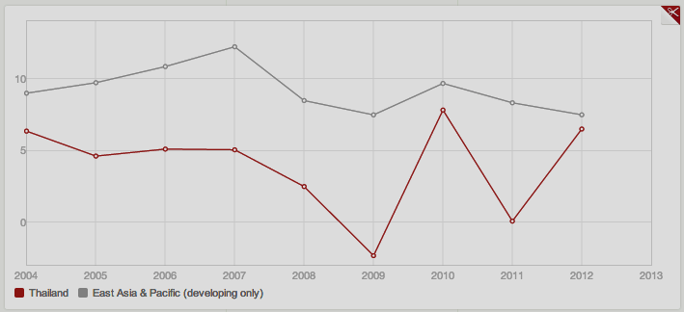
Thailand Insight and SET Index
Figure: GDP Growth (Annual %) of Thailand and East Asia Pacific
Source: World Bank Data

Slide 5
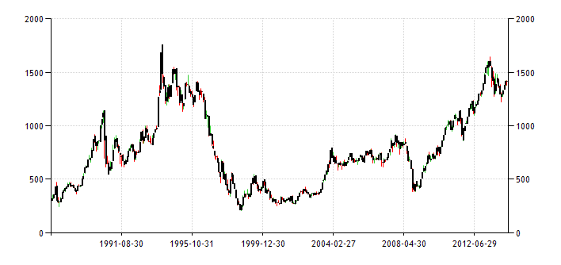
Thai Stock Market Performance
Lehman Brother Crisis
Floods
Figure 1: Thai stock index (SET) performance from 1987-2014
Source: Trading Economic

Slide 6
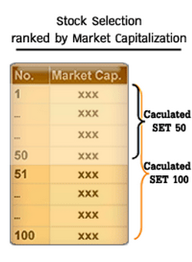
SET Index Series
SET Index ( Composite):
Capitalization-weighted price index
Calculated from the prices of all common stocks (with certain exceptions)
Adjustment: in line with changing of the values of stocks and number of stocks
Base value: 100 points
Base date: April 30, 1975
SET 50 Index (Large-cap Index)
Capitalization-weighted price index
Calculated from the prices of 50 selected SET stocks
Adjustment: in line with changing of the values of stocks and number of stocks
Base value: 100 points
Base date: April 30, 1995
Figure 1: Stock selection for SET 50
Source: The Stock Exchange of Thailand

Slide 7
Study of Seasonality in Stock Index
Literature Reviews:
Bouman and Jacobsen (2002) found evidences for Halloween effects across 36 stock markets in the total of 37 observed countries including Thailand.
Maberly and Pierce (2003) documented Halloween effect in Japanese equity market over prior years of the mid-1980s. This effect was strongly evident over bull market observed in the data set.
Gultekin M. and Gultekin B. (1983) documented that significantly large mean returns were found at the turn of tax year in stock markets observed in 18 countries. Remarkably, January was the month with significantly high return.
Fountas and Segredakis (2002) tested eighteen emerging stock markets for the period 1987-1995 including Thailand and found that January effect and tax-loss selling hypothesis were not statistically supported in stock markets being observed. In the other words, the result supported the existence of EMH those stock markets.
In previous study, we found “Halloween effect” in VN-index during the observed period from July 2000 to December 2010. The effect primarily occurred between 2000 and 2007. In addition, January has highest average return over the period 2000-2010, which supports for the January effect. (“Seasonality in the Vietnam Stock Index”).
Is Thai stock market efficient??

Slide 8
Research Data and Methodology
Examine the SET Composite and SET 50 since the stock exchanges was established in May 1975 to December 31st, 2013 inclusively.
SET monthly returns are calculated from daily returns using the following equation:

Slide 9
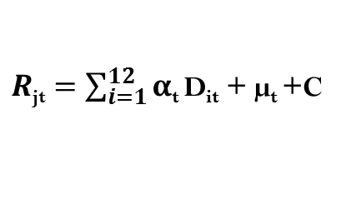
Methodology
In this paper, we use Brauer and Chang’s (1990) model:
Where:
$R$_{jt} is the return on j index in month t^{th}
D_{it} is a dummy variable which takes value of 1 if the month is t^{th} and zero otherwise
α_{t}: represents the coefficient for the month t^{th}
The second model we use in our examination to test Halloween effect comes from Lucey and Zhao’s (2008) model:
Where:
R_{j}­_{t} is the return on index j in the month t^{th}
W_{t} is dummies for Halloween indicator, which takes value 1 if the month falls from November to April and zero otherwise
β: represents the coefficient for Halloween indicator

Slide 10
TABLE I Mean Monthly Returns for SET and SET 50 Index (%)
Aver. Monthly* | SET50 (1996-2013) | SET (1996-2013)
Jan | 2.54 | 2.47
Feb | 1.85 | 0.58
Mar | -0.70 | -0.41
Apr | 0.13 | 1.47
May | -0.65 | 0.27
Jun | -0.13 | 1.25
Jul | -0.46 | 1.23
Aug | -2.19 | 0.16
Sep | 2.07 | 0.34
Oct | -1.11 | 1.34
Nov | -0.08 | -0.38
Dec | 4.20 | 3.02
May-Oct HPR | 0.98 | 1.04
Nov-Apr HPR | 1.08 | 1.07
Initial Evidences:
Higher mean returns for Jan and Dec.
“Halloween” effect might be present in this market.
*Average monthly returns across the years being observed
Source: Quandl Dataset

Slide 11
TABLE II Mean and Standard Deviation for SET and SET50 Index
More volatile
** November-April Holding Period Return (HPR) is calculated the months within the calendar year for tax purposes.
63.16% of positive returns for Nov-Apr as compared to 50% positive returns for May-Oct for SET Index.
Similarly, 66.67% of positive returns as compared to only 38.89% for SET50 Index.
Significantly, 87.5% and 50% respectively for SET100 Index.

Slide 12
TABLE III The Test of Seasonal Effects for SET Indices
SET Index
(1975-2013)
SET50 Index
(1995-2013)
The results support for December effect (SET Index) and January effect (SET50 Index).

Slide 13
TABLE IV Summary Statistics for Halloween Effect Adjusted with December Effect for SET Composite Index (1975-2013)
This suggest that Halloween effect is statistically explained by December effect

Slide 14
TABLE V: Summary Statistics for Halloween Effect Adjusted with January Effect for SET 50Index (1995-2013)
This result is consistent with findings of Bouman and Jacobsen (2001) when they found that in many countries including Thailand, Halloween effect is the January effect in disguise.

Slide 15
January effect and Tax loss selling hypothesis
To further explore the tax loss selling hypothesis associated with SET 50 Index, the following regression model is estimated:
January return = f (prior years return, prior years standard deviation of returns).
Tax loss selling in theory:
The coefficient of January returns and prior year returns should be negative.
Standard deviation of returns for prior years should be positive as the market is more volatile to generate more losses.

Slide 16
TABLE VI Regression Analysis for January Returns SET 50 Index
Explanatory
Variables
Dependent Variable
The results support the tax-loss selling hypothesis when one would expect the negative coefficient for the previous year’s mean returns and a positive coefficient on the previous year’s standard deviation of returns.

Slide 17
Conclusions
Halloween effect on both SET Composite and SET50 are not strongly supported during the observed periods respectively.
December effect statistically explains for Halloween effect for SET Composite index.
Halloween effect for SET 50 is actually January effect in disguise.
Results statistically support hypothesis of tax-loss selling for SET50 index as January effect exists in the SET market.
Is rainfall negatively correlated with monthly returns?
Follow-up Research: “The Market Pricing of Anomalous Weather: Evidence from Thailand.”

Slide 18
THANK YOU !
Questions ???

