Slide 1
Brigham & Ehrhardt
Financial Management:
Theory and Practice 14e

Slide 2
CHAPTER 17
Multinational Financial Management

Slide 3
Topics in Chapter
Factors that make multinational financial management different
Exchange rates and trading
International monetary system
International financial markets
Specific features of multinational financial management

Slide 4
Intrinsic Value in a Global Context
Currency
exchange
rates
Regulatory
systems
Culture
Free cash flow
(FCF)
FCF₁
FCF₂
FCF∞
Value = + + ···+
(1 + WACC)¹
(1 + WACC)²
(1 + WACC)∞
Weighted average
cost of capital
(WACC)
Cost of debt
Cost of equity
Global financial markets
Political risk

Slide 5
What is a multinational corporation?
A multinational corporation is one that operates in two or more countries.
At one time, most multinationals produced and sold in just a few countries.
Today, many multinationals have world-wide production and sales.

Slide 6
Why do firms expand into other countries?
To seek new markets.
To seek new supplies of raw materials.
To gain new technologies.
To gain production efficiencies.
To avoid political and regulatory obstacles.
To reduce risk by diversification.

Slide 7
Major Factors Distinguishing Multinational from Domestic Financial Management
Currency differences
Economic and legal differences
Language differences
Cultural differences
Government roles
Political risk

Slide 8
Consider the following exchange rates:
 | U.S. Dollars Required to Buy One Unit of Foreign Currency | Units of Foreign Currency Required to Buy One U.S. Dollar
Euro | 1.2500 | --
Swedish krona | -- | 7.0000

Slide 9
Notation
The notation EUR/USD and SEK/USD use the currency labels designated by the international Organization for Standardization (ISO)
The quotes in the first column express the relative value of the euro to the dollar and the krona to the dollar.
EUR/USD = 1.25
The press would report the euro trading at $1.25.
The quotes in the second column express the relative value of the dollar to the foreign currency.
USD/SEK = 7

Slide 10
Direct Quotations
From a U.S. perspective, the quotes in the first column are called direct quotes because they are number of units of a foreign currency that can be purchased by 1 unit of the home currency.
Direct quote = Dollars per foreign currency

Slide 11
What is an indirect quotation?
An indirect quotation gives the amount of a foreign currency required to buy one unit of home currency. In our example, the U.S. dollar is the home (currency per dollar).
The second column in the previous table shows the indirect quotations.

Slide 12
Standardizing Quotes
Euros and British pounds are normally quoted as direct quotations.
Most other currencies are quoted as indirect.

Slide 13
Calculate the indirect quotation for euros and the direct quotation for kronor.
Indirect Euro: 1 / 1.2500 = 0.8000
Direct Krona: 1 / 7.000 = 0.1429
 | Direct Quote: U.S. $ per foreign currency | Indirect Quotes: # of Units of Foreign Currency per U.S. $
Euro | 1.2500 | 0.8000
Swedish krona | 0.1429 | 7.0000

Slide 14
What is a cross rate?
A cross rate is the exchange rate between any two currencies not involving U.S. dollars.
In practice, cross rates are usually calculated on the basis of U.S. dollar exchange rates.

Slide 15
Calculate the Kronor per euro cross rate.
Cross Rate =
Kronor Dollars Dollar Euros
×
= 7.000 x 1.2500 = 8.750 Kronor/Euro

Slide 16
Euros/Krona Cross Rate
Euros per Krona cross rate is reciprocal of the Kronor per Euro cross rate:
Euros per Krona cross rate = 1/(8.750) = 0.1143

Slide 17
Example of International Transactions
Assume a firm can produce a package of jerky in the U.S. and ship it to France for $1.75. If the firm wants a 50% markup on the product, what should the jerky sell for in France?
Target price = ($1.75)(1.50)=$2.625
(More...)

Slide 18
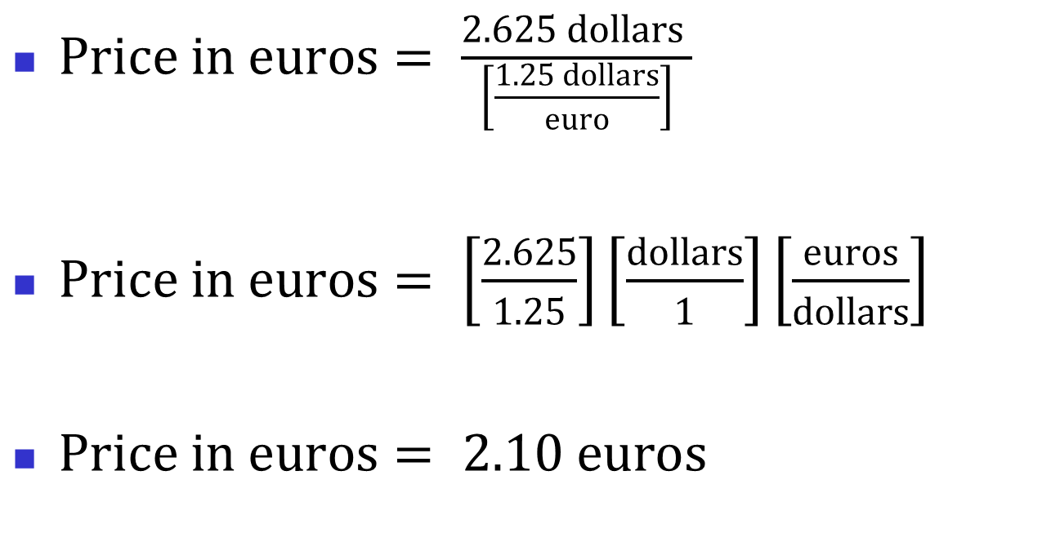
Use the reported exchange rate, which is the direct quote of dollars per euro.
$Price in euros= \frac{2.625 dollars }{\left[\frac{1.25 dollars}{euro}\right]}$
$Price in euros= \left[\frac{2.625}{1.25}\right]\left[\frac{dollars}{1}\right]\left[\frac{euros}{dollars}\right]$
$Price in euros= 2.10 euros$

Slide 19
Could you use the calculated indirect rate for euros per dollar?
Yes, for this particular example:
$2.625 × 0.8 €/$ = €2.10
But this is only true if the indirect rate that is calculated from the reported direct rate is not rounded.

Slide 20
Example (Continued)
Now the firm begins producing the jerky in France. The product costs 2.0 euros to produce and ship to Sweden, where it can be sold for 20 kronor. What is the dollar profit on the sale?
We can use the kronor per euro cross rate to find the Swedish sales revenue because the cross rate has not been rounded (otherwise, we would need to calculate the cross rate ourselves).

Slide 21
Example (Continued)
Revenue =(2.0 euros)(8.50 kronor/euro)
Revenue = 17.5 kronor.
The profit in kronor is:
20 – 17.50 = 2.50 kronor

Slide 22
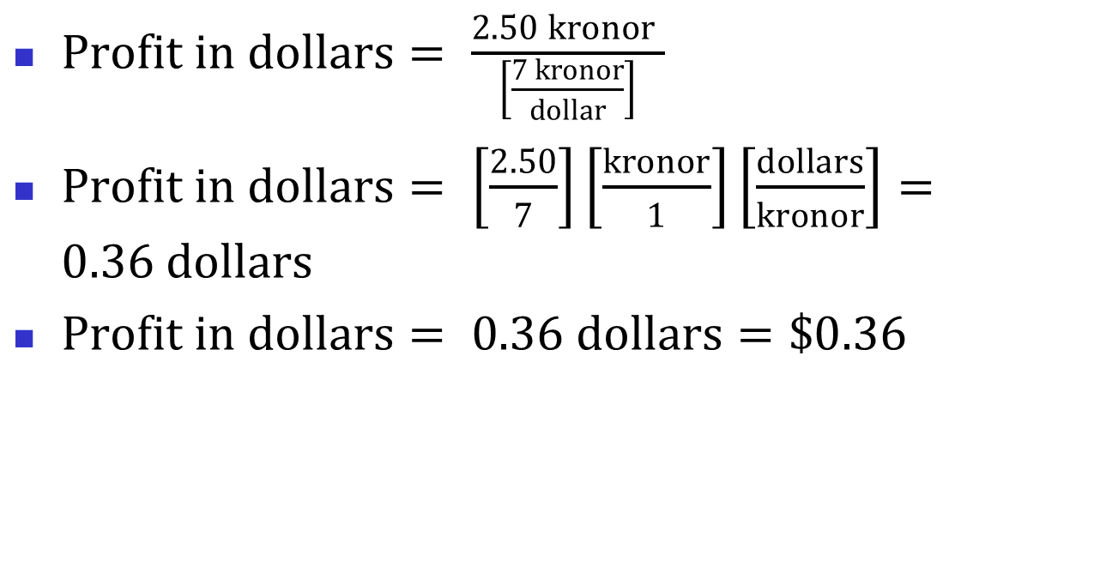
Example (Continued)
$Profit in dollars= \frac{2.50 kronor }{\left[\frac{7 kronor}{dollar}\right]}$
$Profit in dollars= \left[\frac{2.50}{7}\right]\left[\frac{kronor}{1}\right]\left[\frac{dollars}{kronor}\right]=0.36 dollars$
$Profit in dollars= 0.36 dollars=\$0.36$

Slide 23
Example (Continued)
In this example, we need to use the reported 7 kronor per dollar indirect exchange rate or we must calculate the direct rate ourselves and not round it at all.

Slide 24
What is exchange rate risk?
Exchange rate risk is the risk that the value of a cash flow in one currency translated from another currency will decline due to a change in exchange rates.

Slide 25
Currency Appreciation
Suppose the exchange rate goes from 7 kronor per dollar to 9 kronor per dollar.
A dollar now buys more kronor. The percentage increase in kronor per dollar is:
(9 − 7)/7 = 28.6%
We would say that the dollar appreciated against the krona by 28.6%.

Slide 26
The dollar has appreciated, but what about the krona?
Express the exchange rate as dollars per krona to determine how much more or less valuable the krona has become.
Kronor per dollar: 7 ⟹ 9
Dollars per krona: 0.1429 ⟹ 0.1111
The percentage change in dollars per krona:
(0.1429 − 0.1111)/0.1111 = −0.222
Kronor has depreciated against the dollar by 22.2%.

Slide 27
What to Remember about Currency Appreciation and Depreciation
To determine whether currency X has appreciated or depreciated against currency Y:
Write the exchange rate as the number of units of Y per unit of X.
Comparing the old rate with the new rate shows how much more (or less) of currency Y that X can purchase.
The percentage that X appreciates against Y is not the same as the percentage that Y depreciates against X.

Slide 28
Effect of Dollar Appreciation
Suppose the profit in kronor remains unchanged at 2.5 kronor, but the dollar appreciates, so the exchange rate is now 10 kronor/dollar.
Dollar profit = 2.5 kronor / (10 kronor per dollar) = $0.25.
Strengthening dollar hurts profits from international sales.

Slide 29
The International Monetary System from 1946-1971
Prior to 1971, a fixed exchange rate system was in effect.
The U.S. dollar was tied to gold.
Other currencies were tied to the dollar at fixed exchange rates.

Slide 30
Former System (Continued)
Central banks intervened by purchasing and selling currency to even out demand so that the fixed exchange rates were maintained.
Occasionally the official exchange rate for a country would be changed.
Economic difficulties from maintaining fixed exchange rates led to its end.

Slide 31
The Current International Monetary System
The current system for most industrialized nations is a floating rate system where exchange rates fluctuate due to changes in demand.
Currency demand is due primarily to:
Trade deficit or surplus
Capital movements to capture higher interest rates

Slide 32
The European Monetary Union
In 2002, the full implementation of the “euro” was completed (those still holding former currencies had 10 years to exchange them at a bank). The European Central Bank now controls the monetary policy of the EMU countries using the euro.

Slide 33
The European Monetary Union Members that Use the Euro
Austria | France | Italy | Portugal
Belgium | Germany | Luxembourg | Slovenia
Cyprus | Greece | Malta | Spain
Finland | Ireland | Netherlands | Slovakia
Estonia*
*Joined in 2011.

Slide 34
Pegged Exchange Rates
Many countries still used a fixed exchange rate that is “pegged,” or fixed, with respect to another currency.
Examples of pegged currencies:
Chinese yuan, about 6.35 yuan/dollar (Spring 2012)
Chad uses CFA franc, pegged to French franc which is pegged to euro.

Slide 35
What is a convertible currency?
A currency is convertible when the issuing country promises to redeem the currency at current market rates.
Convertible currencies are freely traded in world currency markets.
Residents and nonresidents are allowed to freely convert the currency into other currencies at market rates.

Slide 36
Problems Due to Nonconvertible Currency
It becomes very difficult for multi-national companies to conduct business because there is no easy way to take profits out of the country.
Often, firms will barter for goods to export to their home countries.

Slide 37
Examples of nonconvertible currencies
Chinese yuan
Venezuelan bolivar
Uzbekistan sum
Vietnamese dong

Slide 38
What is the difference between spot rates and forward rates?
A spot rate is the rate applied to buy currency for immediate delivery.
A forward rate is the rate applied to buy currency at some agreed-upon future date.
Forward rates are normally reported as indirect quotations.

Slide 39
When is the forward rate at a premium to the spot rate?
If the U.S. dollar buys fewer units of a foreign currency in the forward than in the spot market, the foreign currency is selling at a premium.
For example, suppose the spot rate is 0.5 £/$ and the forward rate is 0.4 £/$.
The dollar is expected to depreciate, because it will buy fewer pounds.
(More...)

Slide 40
Spot rate = 0.5 £/$ Forward rate = 0.4 £/$.
The pound is expected to appreciate, since it will buy more dollars in the future.
So the forward rate for the pound is at a premium. In other words, the dollar can buy more pounds now than it will be able to in the future, so the future price is at a premium to the current price.

Slide 41
When is the forward rate at a discount to the spot rate?
If the U.S. dollar buys more units of a foreign currency in the forward than in the spot market, the foreign currency is selling at a discount.
The primary determinant of the spot/forward rate relationship is the relationship between domestic and foreign interest rates.

Slide 42
What is interest rate parity?
Interest rate parity implies that investors should expect to earn the same return on similar-risk securities in all countries:
Forward and spot rates are direct quotations.
r_{h} = periodic interest rate in the home country.
r_{f} = periodic interest rate in the foreign country.
Forward rate
Spot rate
1 + r_{h}
1 + r_{f}
=

Slide 43
Interest Rate Parity Example
Assume 1 euro = $1.27 in the 180-day forward market and the 180-day risk-free rate is 6% in the U.S. and 4% in France. Does interest rate parity hold?
Spot rate = $1.25.
r_{h} = 6%/2 = 3%.
r_{f} = 4%/2 = 2%.
(More...)

Slide 44
Interest Rate Parity (Continued)
Forward rate
Spot rate
1 + r_{h}
1 + r_{f}
=
Forward rate
1.25
1.03
1.02
=
Forward rate = 1.2623.
If interest rate parity holds, the implied forward rate, 1.2623, would equal the observed forward rate, 1.2700; so parity doesn’t hold.

Slide 45
Which 180-day security (U.S. or French) offers the higher return?
A U.S. investor could directly invest in the U.S. security and earn an annualized rate of 6%.
Alternatively, the U.S. investor could convert dollars to euros, invest in the French security, and then convert profit back into dollars. If the return on this strategy is higher than 6%, then the French security has the higher rate.

Slide 46
What is the return to a U.S. investor in the French security?
Buy $1,000 worth of euros in the spot market:
$1,000(0.80 euros/$) = 800 euros.
French investment return (in euros):
800(1.02)= 816 euros.
(More...)

Slide 47
U.S. Return (Continued)
Buy contract today to exchange 816 euros in 180 days at forward rate of 1.2700 dollars/euro.
At end of 180 days, convert euro investment to dollars:
€816 (1.2700 $/€) = $1,036.32.
Calculate the rate of return:
$36.32/$1,000 = 3.632% per 180 days
= 7.26% per year.
(More...)

Slide 48
The French security has highest return, even with lower interest rate.
U.S. rate is 6%, so French securities at 7.26% offer a higher rate of return to U.S. investors.
But could such a situation exist for very long?

Slide 49
Arbitrage
Traders could borrow at the U.S. rate, convert to euros at the spot rate, and simultaneously lock in the forward rate and invest in French securities.
This would produce arbitrage: a positive cash flow, with no risk and none of the traders own money invested.

Slide 50
Impact of Arbitrage Activities
Traders would recognize the arbitrage opportunity and make huge investments.
Their actions would tend to move interest rates, forward rates, and spot rates to parity.

Slide 51
What is purchasing power parity?
Purchasing power parity implies that the level of exchange rates adjusts so that identical goods cost the same amount in different countries.
P_{h} = P_{f}(Spot rate),
or
Spot rate = P_{h}/P_{f}.

Slide 52
U.S. jerky is $2.00/package. If purchasing power parity holds, what is price in France?
Spot rate = P_{h}/P_{f}.
$1.2500= $2.00/P_{f}
P_{f} = $2.00/$1.2500
= 1.6 euros.
Do interest rate and purchasing power parity hold exactly at any point in time?

Slide 53
Impact of relative Inflation on Interest Rates and Exchange Rates
Lower inflation leads to lower interest rates, so borrowing in low-interest countries may appear attractive to multinational firms.
However, currencies in low-inflation countries tend to appreciate against those in high-inflation rate countries, so the true interest cost increases over the life of the loan.

Slide 54
Describe the international money and capital markets.
Eurodollar markets
Dollars held outside the U.S.
Mostly Europe, but also elsewhere
International bonds
Foreign bonds: Sold by foreign borrower, but denominated in the currency of the country of issue.
Eurobonds: Sold in country other than the one in whose currency it is denominated.

Slide 55
To what extent do capital structures vary across different countries?
Early studies suggested that average capital structures varied widely among the large industrial countries.
However, a recent study, which controlled for differences in accounting practices, suggests that capital structures are more similar across different countries than previously thought.

Slide 56
Multinational Capital Budgeting Decisions
Foreign operations are taxed locally, and then funds repatriated may be subject to U.S. taxes.
Foreign projects are subject to political risk.
Funds repatriated must be converted to U.S. dollars, so exchange rate risk must be taken into account.

Slide 57
Foreign Project Analysis
Project future expected cash flows, denominated in foreign currency
Use the interest rate parity relationship to convert the future expected foreign cash flows into dollars.
Discount the dollar denominated cash flows at the risk-adjusted cost of capital for similar U.S. projects.

Slide 58
Capital Budgeting Example
U.S. company invests in project in Japan.
Expected future cash flows:
CF₀ = - ¥1,000 million.
CF₁ = ¥500 million.
CF₂ = ¥800 million.
Risk-adjusted cost of capital for a similar U.S. project = 10%.

Slide 59
Interest Rate and Exchange Rate Data
Current spot exchange rate = 110 ¥/$.
U.S. government bond rates:
1-year bond = 2.0%
2-year bond = 2.8%
Japan government bond rates:
1-year bond = 0.05%
2-year bond = 0.26%

Slide 60
Multi-year Interest Rate Parity Relationship
Exchange rates are direct quotations.
r_{h} = annual interest rate in the home country.
r_{f} = annual interest rate in the foreign country.
Expected future
exchange rate
Spot rate
1 + r_{h} ^{t}
1 + r_{f}
=

Slide 61
Expected Future Exchange Rates (Continued)
Direct spot rate = (1/110 ¥/$) = 0.009091 $/¥.
Expected exchange rate in 1 year:
= (Spot rate)[(1+r_{h})/(1+r_{f})]¹
= (0.009091)(1+0.02)/(1+0.0005)
= 0.009268

Slide 62
Expected Future Exchange Rates (Continued)
Expected exchange rate in 2 years:
= (spot rate)[(1+r_{h})/(1+r_{f})]²
= (0.009091)[(1+0.028)/(1+0.0026)]²
= 0.009557

Slide 63
Project Cash Flows
 | 0 | 1 | 2
Cash flows in yen | -¥1,000 | ¥500 | ¥800
Expected exchange rates | 0.009091 | 0.009268 | 0.009557
Cash flows in dollars | -$9.09 | $4.63 | $7.65

Slide 64
Project NPV
$4.63
$7.65
NPV = -$9.09
+
+
(1 + 0.10)
(1 + 0.10)²
NPV = $1.44 million.

Slide 65
International Cash Management
Distances are greater.
Access to more markets for loans and for temporary investments.
Cash is often denominated in different currencies.

Slide 66
Multinational Credit Management
Credit is more important, because commerce to lesser-developed countries often relies on credit.
Credit for future payment may be subject to exchange rate risk.
Many companies buy export credit risk insurance when granting credit to foreign customers.

Slide 67
Multinational Inventory Management
Inventory decisions can be more complex, especially when inventory can be stored in locations in different countries.
Some factors to consider are shipping times, carrying costs, taxes, import duties, and exchange rates.

